Slide 1

School of E&EE
FACULTY OF ENGINEERING
Data Communications and Network Security
ELEC5471M
Section 3. The Network Layer and IP.

Slide 2
Data Communications and Network Security
Learning Objectives To provide students with a knowledge and understanding of data communications and wireless sensor networks and how they are, and could be, used in a range of applications. (See module catalogue).
I will cover these objectives by:
Introductory lecture and the ISO/OSI 7-layer protocol architecture.
The Internet and the TCP/IP architecture.
You will examine the transport layer and in particular TCP and UDP.
Examining the way in which security can be provided across networks will be considered.
We’ll consider the functions of the network layer and IP.
We will develop methods of sharing a common transmission medium (MAC).

Slide 3
Data Communications and Network Security
What must you contribute?
Lectures will be the basic provision of material but YOUR private study is also required.
Also you need to do the web examples suggested, you need to read from all the advised texts and consult the other suggested texts.
You must spend time before each lecture preparing yourself for what the lecture will be about and after each lecture going over the content and checking your understanding.
The Assessment of the module:
Will check you have all met the learning objectives.
Will grade to what extent you have exceeded the objectives.
The exam questions I set will be on:
The layered protocol architectures (ISO and TCP/IP).
The transport layer and sessions across a network, TCP & UDP operation (including congestion control).
Network layer issues (including addressing and routing).
Link layer issues (e.g. MAC).
There will also be a project on the security aspects.

Slide 4
Data Communications and Network Security ELEC5471M
To be given by:
Prof A. H. Kemp
Possibly with support from experts studying in the field.
Assessment will be by 1 exam of 3 hours duration.
Advised texts:
Computer Networking by Kurose and Ross ISBN:0201976994
Protocols and architectures for wireless sensor networks by Holger, K. and Willig, A. Hoboken, NJ : Wiley, 2007, c2005.
Computer Networks, by Tanenbaum ISBN:0133499456
Multimedia communications by Halsall ISBN:0201398184
Also for general reading:
Data & Computer Communications, by Stallings ISBN:0135712742

Slide 5
The Network Layer & Internet Protocol
Addressing
IPv6 (& IPv4 interoperability)
Routing (link-state, distance vector, Internet, Routers)

Slide 6
The Network Layer & Internet Protocol
Internet Protocol
IP Addresses
Addressing over the Internet is a crucial issue.
IPv4 is prevalent and several addressing schemes exist.
IPv6 has been defined and introduced and will soon become dominant across the Internet. It has a different addressing solution.

Slide 7
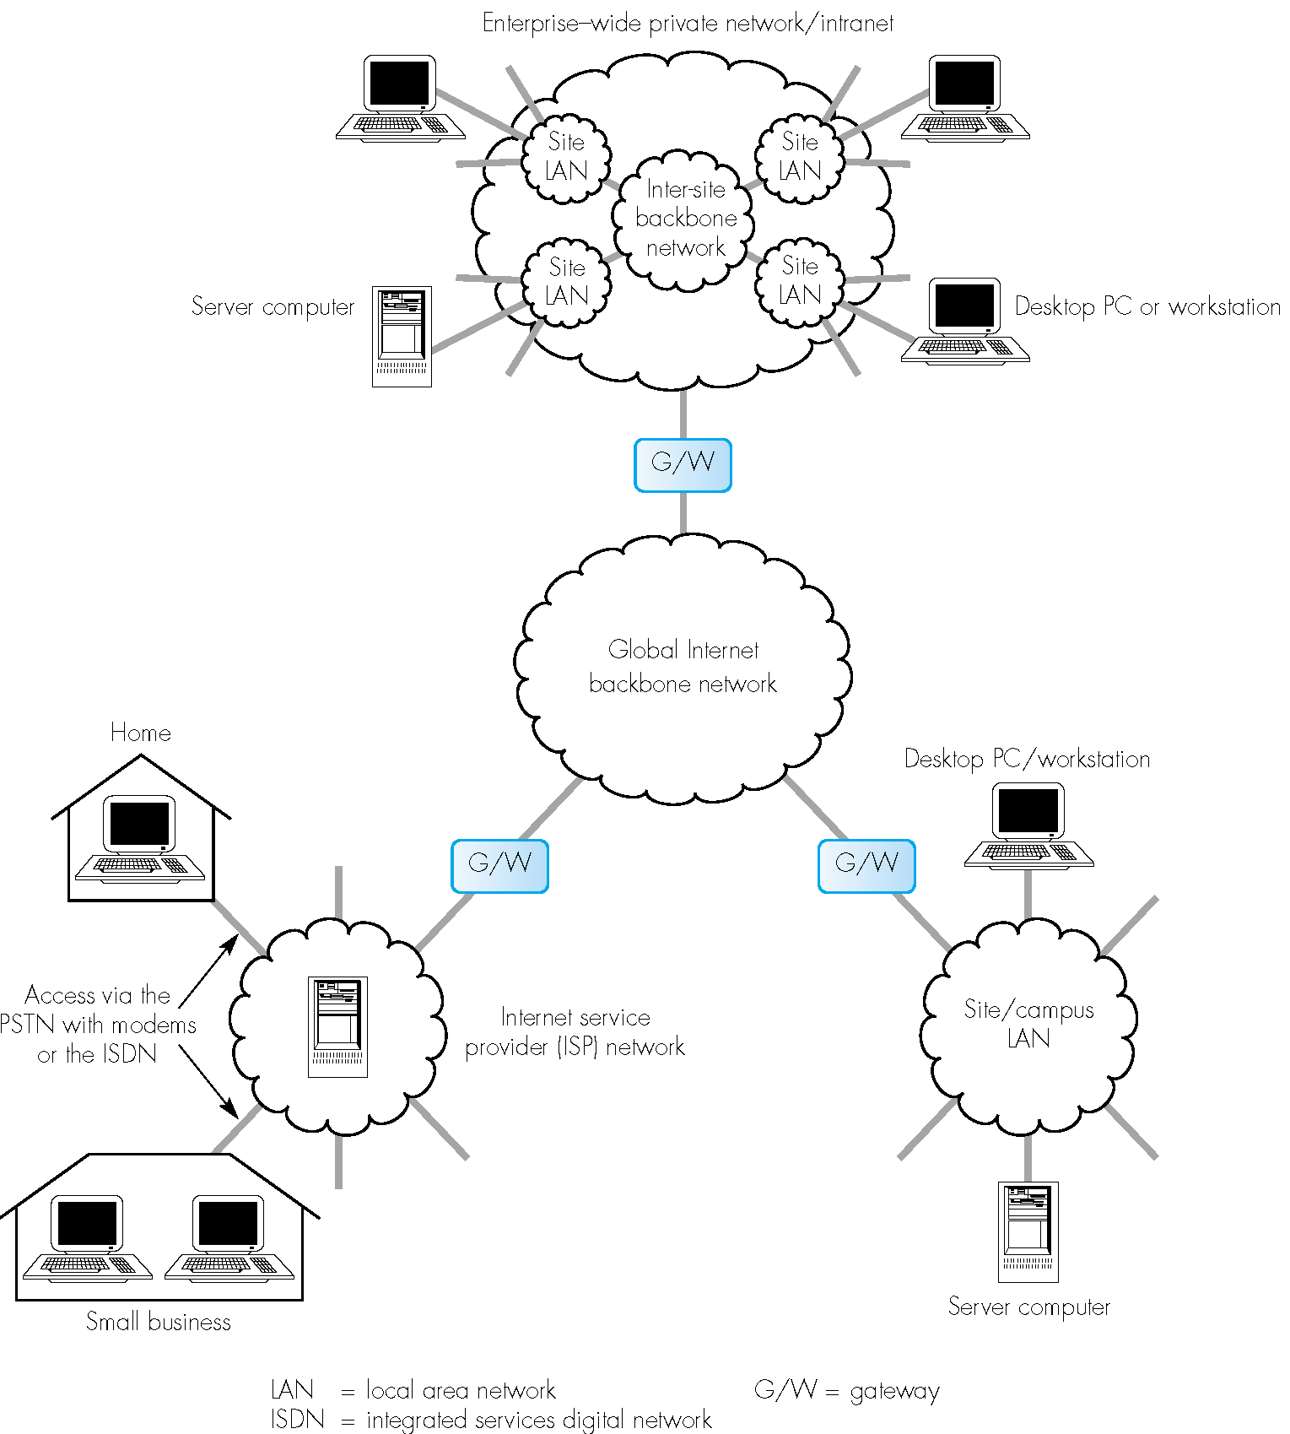
Context:

Slide 8
The Network Layer & Internet Protocol
Internet Protocol
Addressing
Each host, gateway, router (interface) has a unique Internet-wide IP address assigned to it.
The address can be broken down into a net-id and a host-id.
IPv4 defines a 32-bit address space and 4 schemes have been used to better utilize this. A fifth scheme uses a wider address space.

Slide 9
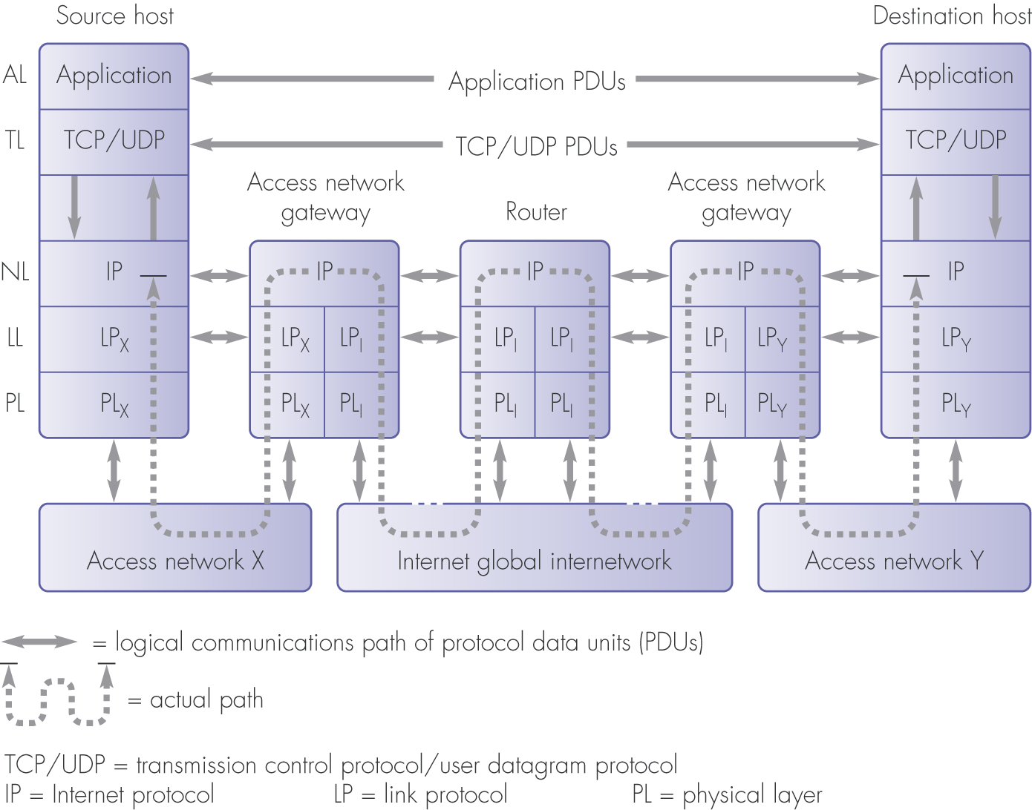
Net-work layer context

Slide 10
IPv4 datagram format
IP protocol version
number
32 bits
total datagram
length (bytes)
header length
(bytes)
ver
head.
len
type of
service
length
for
fragmentation/
reassembly
“type” of data
flgs
fragment
offset
16-bit identifier
max number
remaining hops
(decremented at
each router)
time to
live
upper
layer
Internet
checksum
32 bit source IP address
upper layer protocol
to deliver payload to
32 bit destination IP address
Options (if any)
E.g. timestamp,
record route
taken, specify
list of routers
to visit.
data
(variable length,
typically a TCP
or UDP segment)

Slide 11
Internet Protocol, addressing schemes
IPv4 32-bit addresses
Class-based addresses. (5 address classes)
Subnetting. (To allow single address per site)
Classless addresses. (Removed fixed class boundaries)
Network address translation. (NAT; assigns single IP address per access network).
IPv6 128-bit addresses
Massive increase in addresses.
Notes:
2^32 = 4292967296 = 4.3 x 10^9 =4,000 million
2^128 = 3.40282366920… x 10^38 = 300 million million million million
million
million.

Slide 12
Internet Protocol, addressing schemes
IPv4 addresses are referred to by dotted decimal notation.
The 32-bit address is broken in 4 bytes.
Each byte is converted to decimal.
The address is referred to as four decimal numbers with full-stops (periods) between them.
10000000 00000011 00000010 00000011 = 128.3.2.3
This is class B, netid 128.3 and hostid 2.3

Slide 13
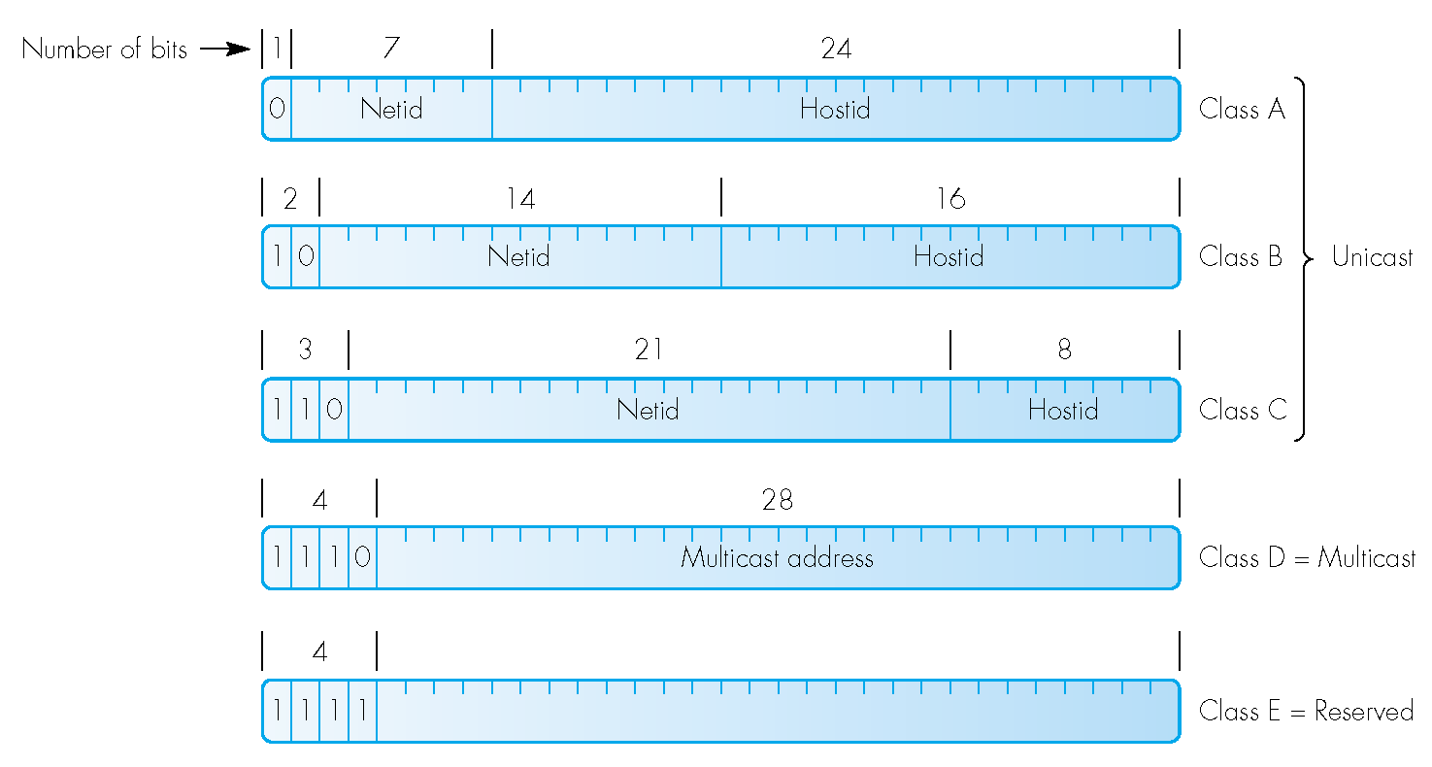
Internet Protocol, addressing schemes
Class-based addresses
32-bit address divided into five classes A, B, C, D, E:

Slide 14
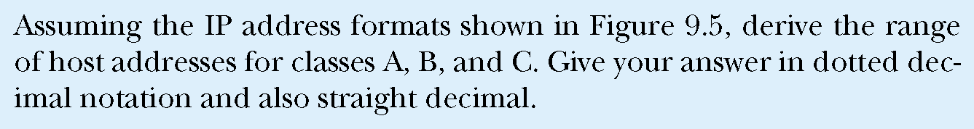
Internet Protocol, addressing schemes
Dotted decimal notation example:
previously

Slide 15
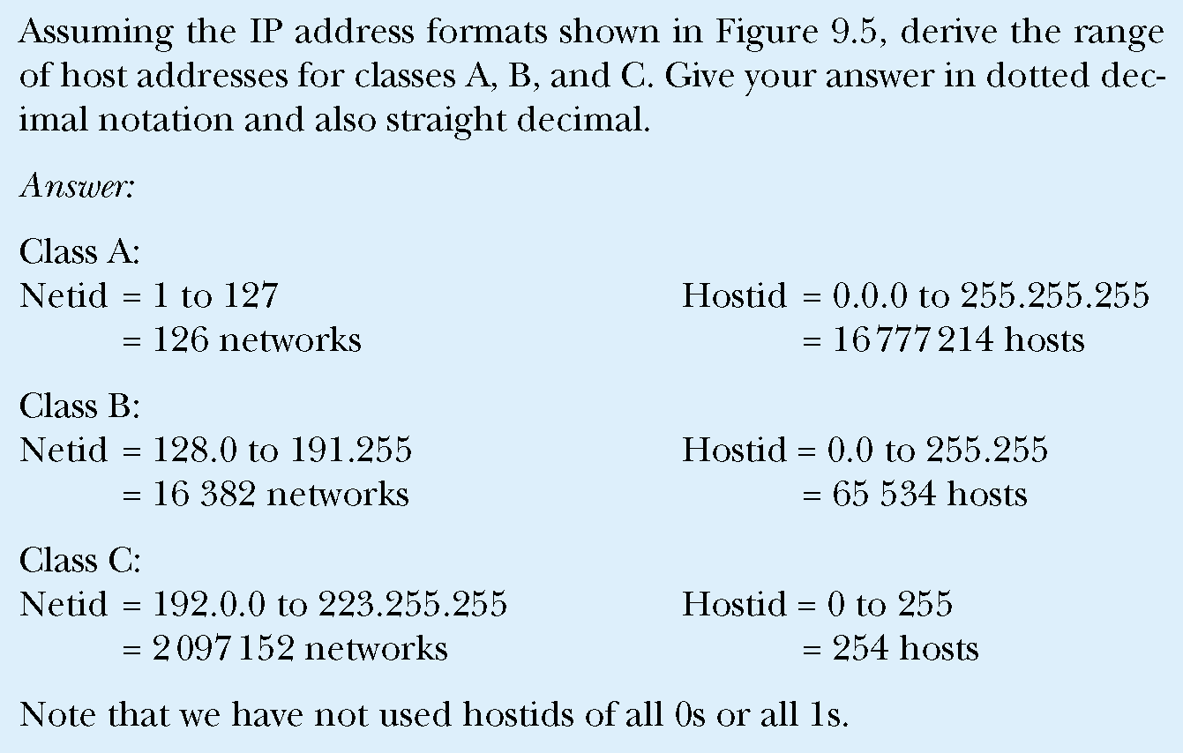
Internet Protocol, addressing schemes
previously

Slide 16
Class-based addresses
Internet Protocol, addressing schemes
Classes A, B & C are for unicast, D for multicast and E is reserved.
Class A has a 7-bit Net-ID field and 24-bit Host-ID field.
Class B 14-bit Net-ID field and 16-bit Host-ID field.
Class C 21-bit Net-ID field and 8-bit Host-ID field.
Host-IDs of all 0s or 1s are special:
0s refers to network (in the Net-ID)
1s means broadcast the packet over the destination network (in the NetID part).
Net-IDs of all 0s or 1s are special:
0s means the same network as the source network (NetID).
Address of all 1s means broadcast the packet over the source network.

Slide 17
Class-based addresses
Internet Protocol, addressing schemes
Class D addresses are reserved for multicasting.
Assigned by ICANN
Mainly used for conferences etc.
Permanent multicast group addresses:
224.0.1 : All hosts on broadcast network.
224.0.2 : All routers on the same site network.

Slide 18
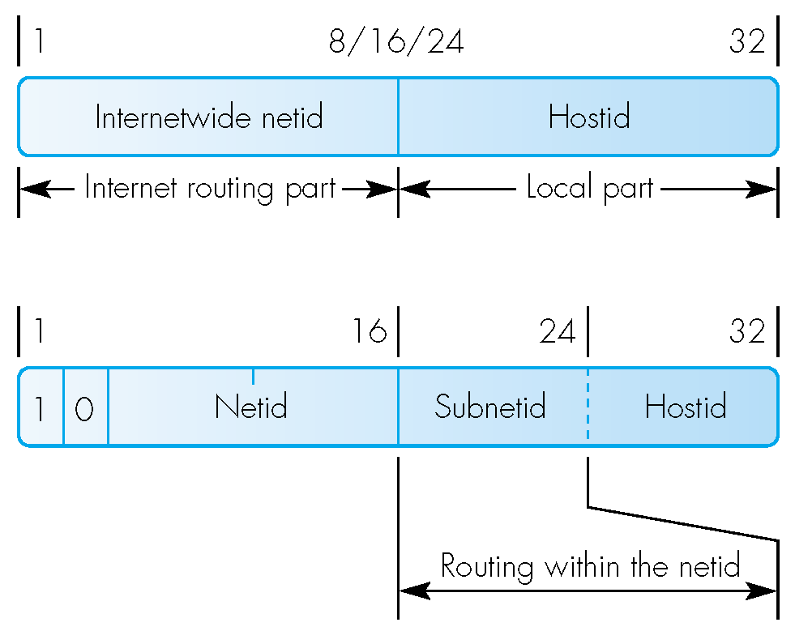
Internet Protocol, addressing schemes
Subnetting.
This is a method to reduce the required number of netids i.e. where many routers are used rather than MAC bridges.
NetID now refers to a complete site (rather than a single subnet).
Netid is Internet part.
HostID consists of 2 subfields: subnetid and local hostid
Routers on local site are subnet routers.

Slide 19
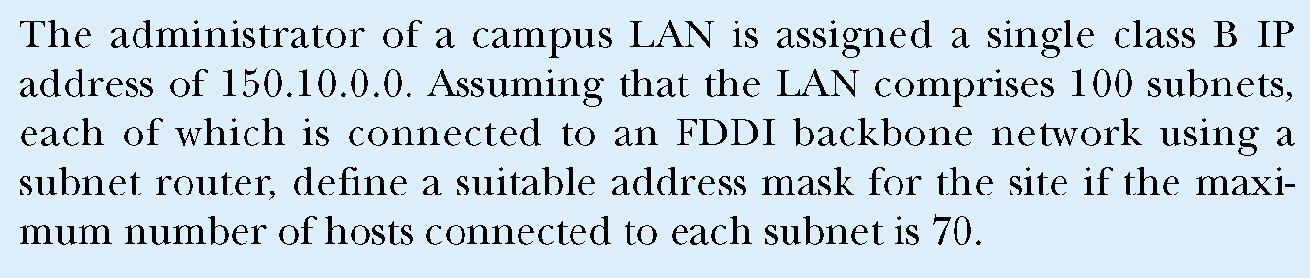
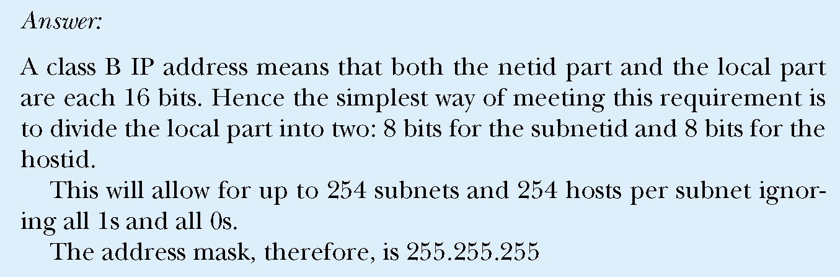
Internet Protocol, addressing schemes

Slide 20
Internet Protocol, addressing schemes
Classless addresses
The definition of network part of the IP address can now be any number of bits.
Address expressed in dotted decimal as w.x.y.z / n .
Where n now indicates the number of bits in the network part of the address.
E.g. if a network requires say 1000 host addresses it can have address w.x.y.z/22 i.e. the first 22 bits represent the netid and the last 10 bits the hostid.
Uses Classless Inter-domain routing (CIDR)

Slide 21
Internet Protocol, addressing schemes
Network address translation (NAT)
This is basically a temporary fix as IP(v4) addresses are running out.
An intermediary (a NAT router or Access gateway) uses transport layer information to save on Network layer addresses!
A reserved number of IP addresses are kept as ‘private addresses’ i.e. addresses not to be used on the Internet.
TCP uses port addresses to indicate processes and in effect these are used to address the ‘private addresses’.

Slide 22
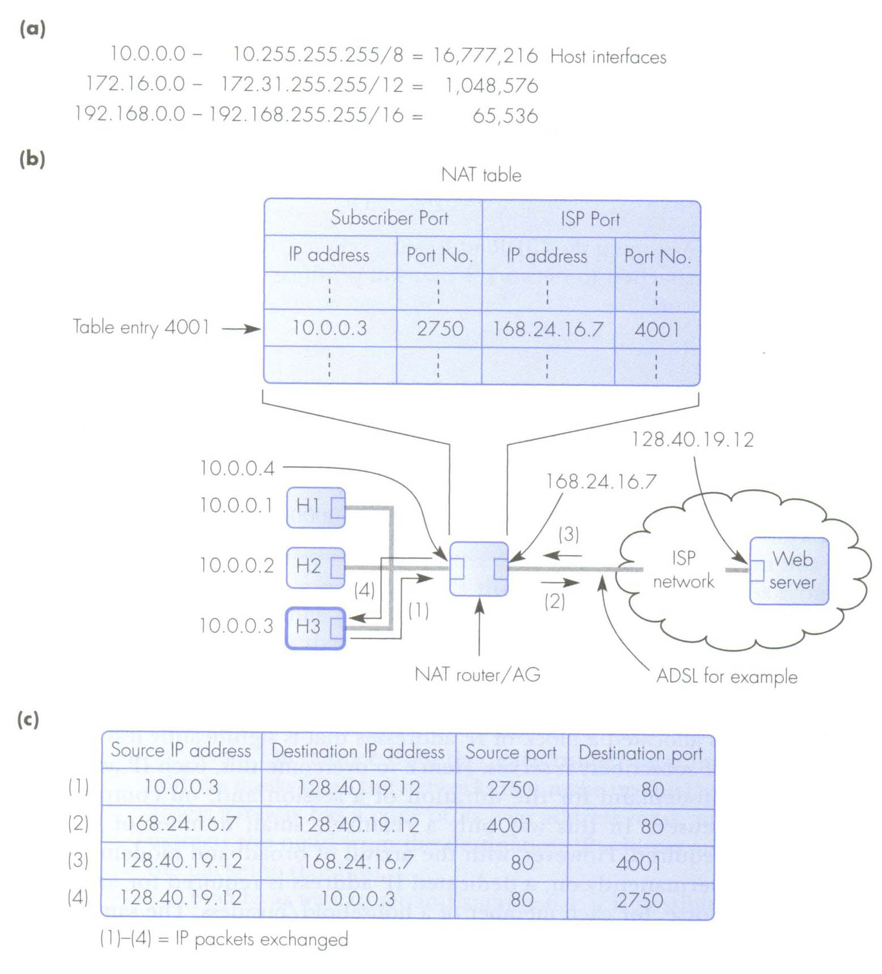
Network address translation:
a) blocks of private addresses,
b) NAT operation,
c) IP/TCP header fields.

Slide 23
Internet Protocol, addressing schemes
IPv6
The long term solution to the chronic shortage of Internet addresses is the introduction of IPv6.
Uses 128-bit address field.
More IPv6 addresses than grains of sand on the planet!

Slide 24
IPv6
The main features offered by IPv6 are:
Increased address space (2¹²⁸ addresses!)
Hierarchical addresses
Simplified header
Improved security
Autoconfiguration facility
QoS guarantees
Support of mobile computing

Slide 25
IPv6
Compared to IPv4 a number of fields have been dropped or made optional.
Main/basic header is 40 bytes.
Version: 6
Traffic class is similar to ToS of IPv4. 4-bit priority

Slide 26
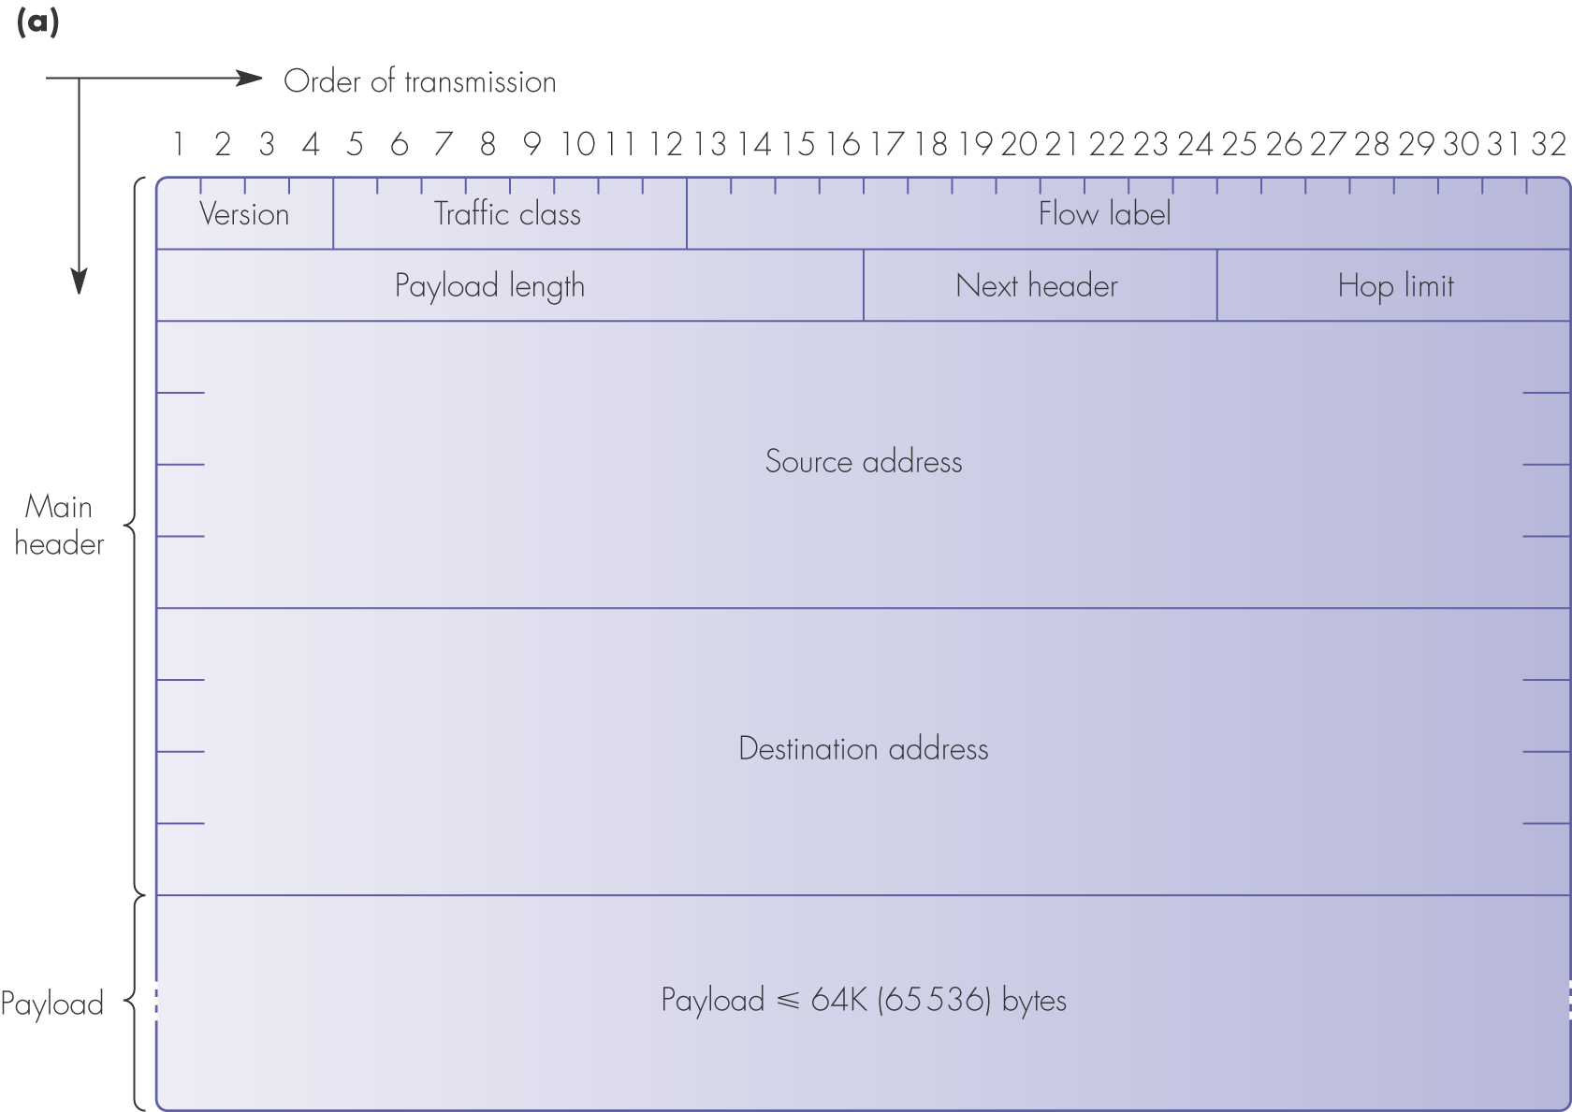

Slide 27
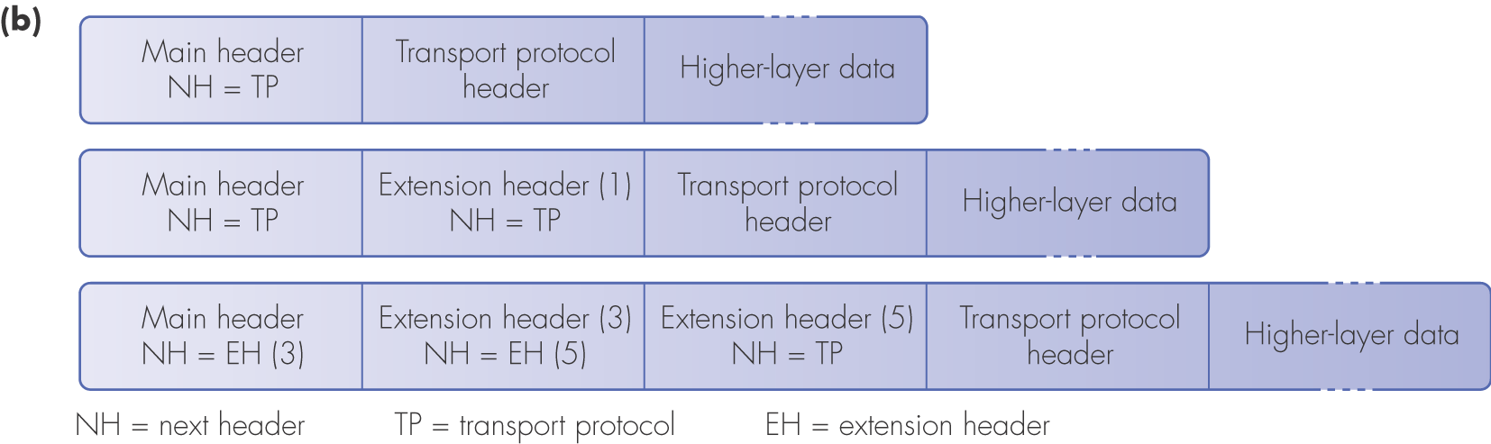
Internet Protocol, addressing schemes
IPv6 not only offers more addresses it also provides better QoS support, more efficient service and better flexibility.
IPv6 position and order of extension headers:
EH (1)

Slide 28
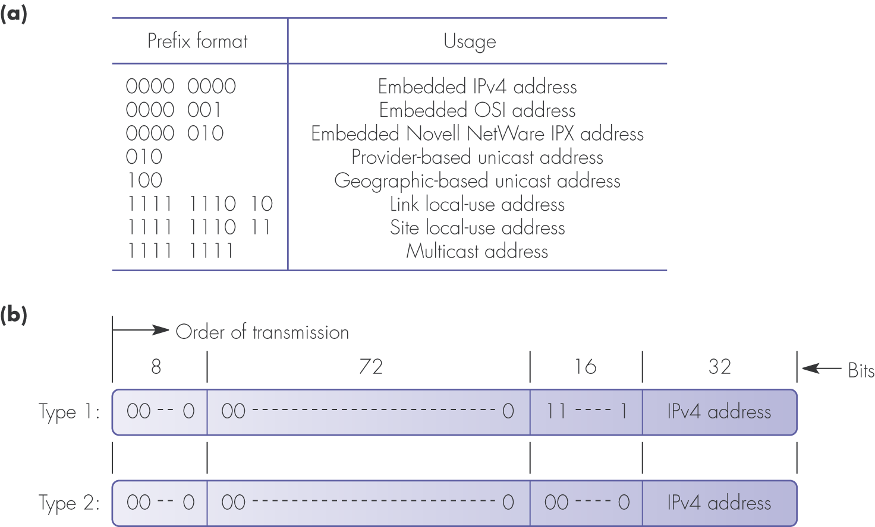
Internet Protocol, addressing schemes
IPv6 needs to exist with IPv4:
IPv6 addresses: (a) prefix formats and their use; (b) IPv4 address types

Slide 29
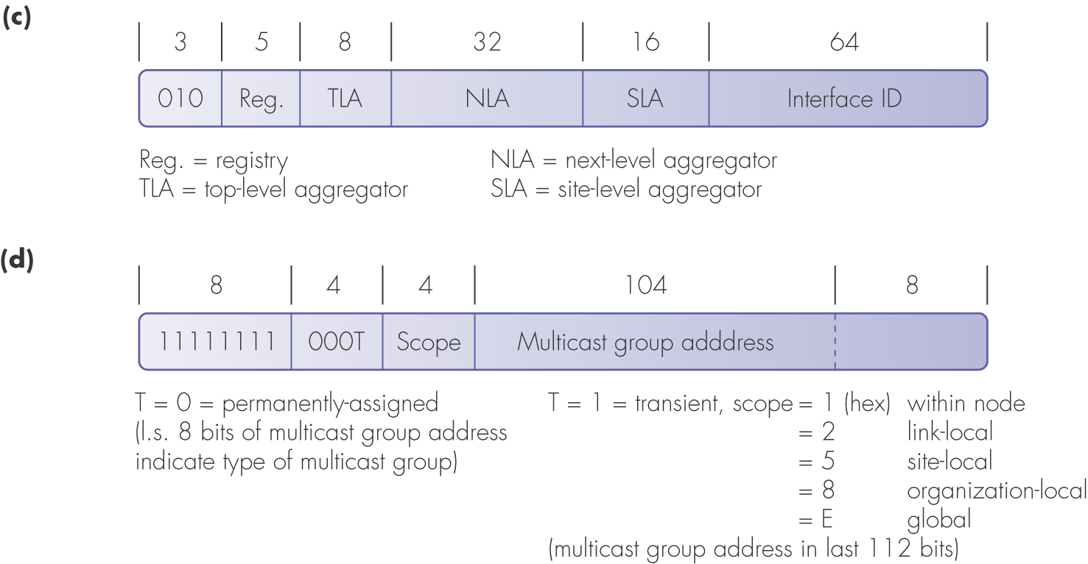
Internet Protocol, addressing schemes
IPv6 addresses: (c) provider-based unicast address format; (d) multicast address format

Slide 30
Internet Protocol, IPv6 addressing
The way IPv6 addresses are written down:
IPv6 addresses are written as 8 groups, each of 16 bits.
Each group is represented as 4 hexadecimal characters.
Colons (:) separate the groups.
All zero groups (:0000:) are dropped and leading zeros are dropped.
E.g. 1111111011011100101110101001100001110110..
= FEDC:BA98:7654:3210:0000:0123:0000
Written as:
FEDC:BA98:7654:3210::123:

Slide 31
IPv4 and IPv6 Interoperability
Widespread deployment of IPv4 makes switch-off impractical.
3 different cases must be catered for:
IPv4 and IPv6 hosts communicating with a single server.
IPv6 source and destination communicating across IPv4 sections of network.
IPv6 host communicating with an IPv4 host.

Slide 32
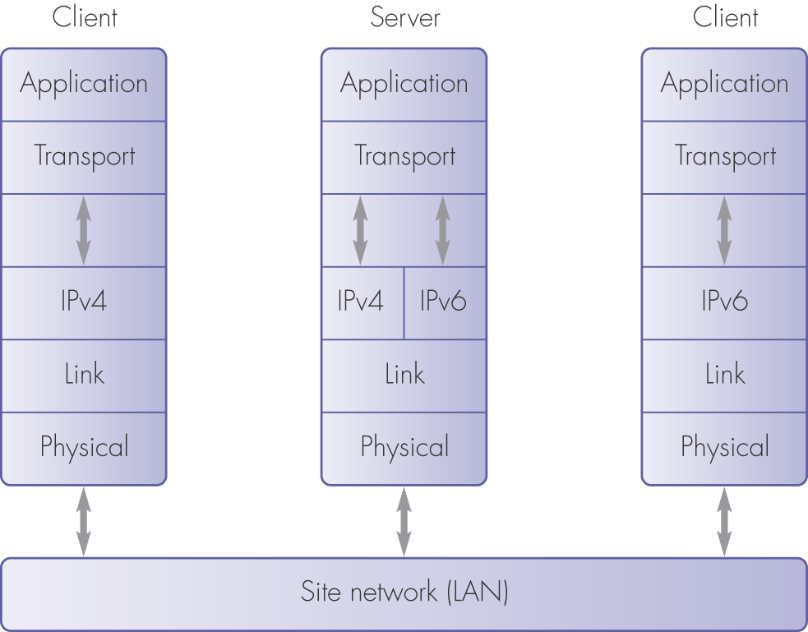
1. IPv4 and IPv6 hosts communicating with a single server
IPv6/IPv4 interoperability using dual (IPv6/IPv4) protocols

Slide 33
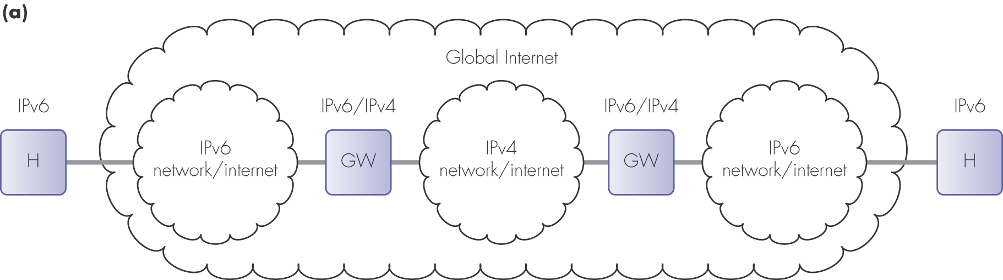
2. IPv6 source and destination communicating across IPv4 sections of network
IPv6/IPv4 interoperability using dual stacks and tunneling: (a) schematic

Slide 34
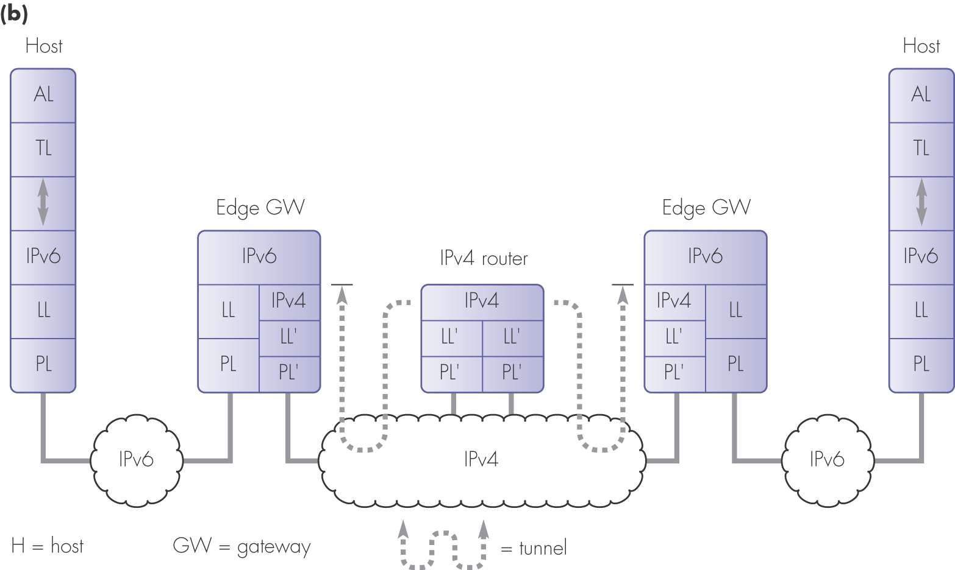
IPv6/IPv4 interoperability using dual stacks and tunneling: (b) protocols

Slide 35
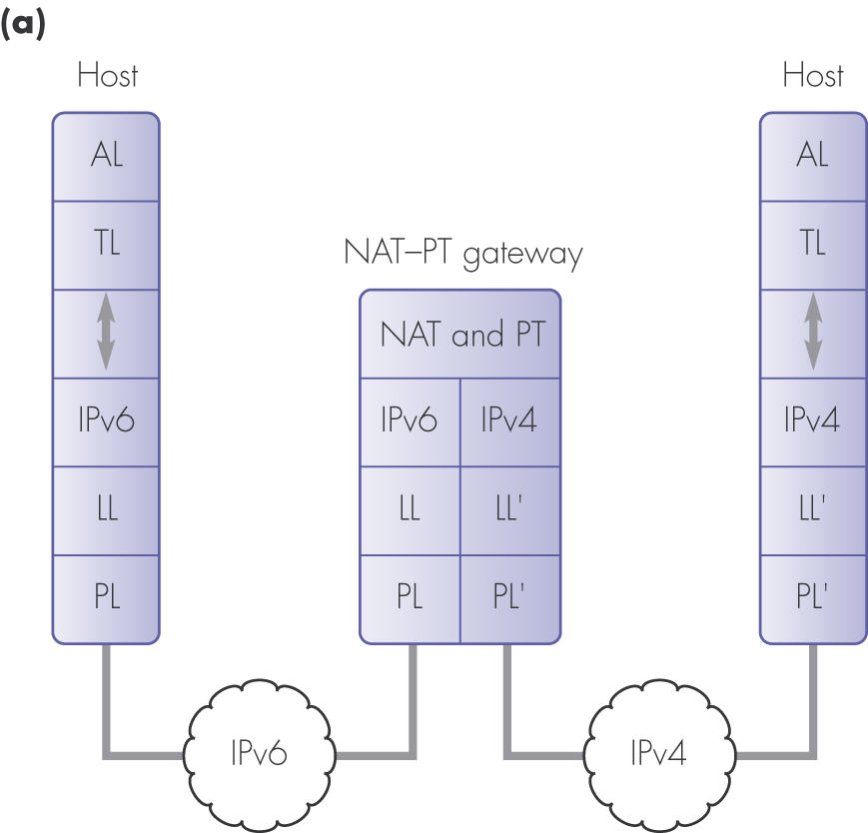
3. IPv6 host communicating with an IPv4 host.
IPv6/IPv4 interoperability using translators: (a) network level

Slide 36
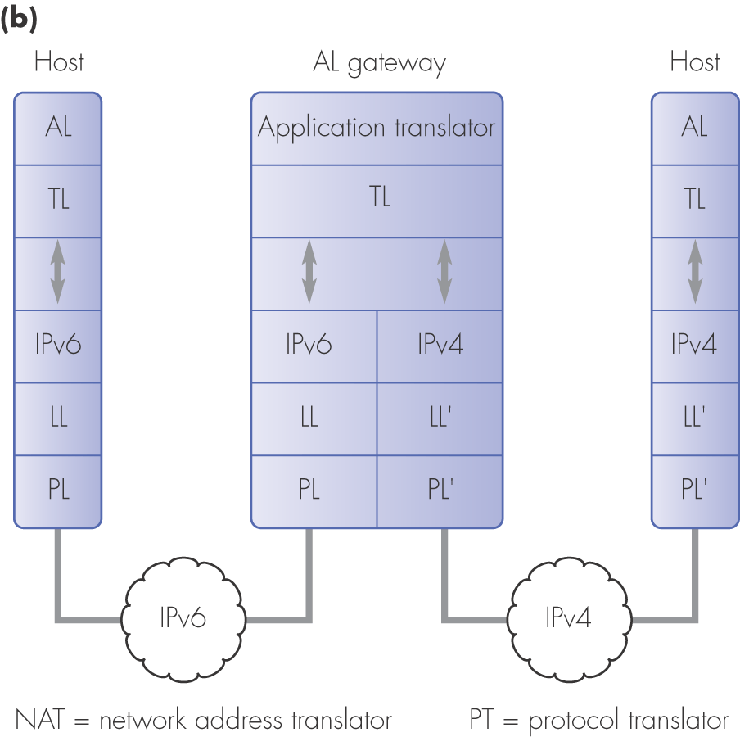
IPv6/IPv4 interoperability using translators: (b) application level

Slide 37
IP Summary items:
IPv4 and addressing
Addressing: dotted decimal notation
Classless, subnetting, NAT
IPv6
Addressing, functions, operation
8 Groups of 4 Hex digits.
Interoperation with IPv4

Slide 38
Key Network layer function: Routing
Routing (link-state, distance vector, Internet, Routers)
QoS Routing
Routing in Wireless Networks

Slide 39
Network Layer
Introduction
What’s inside a router
IP: Internet Protocol
Routing algorithms
Link state
Distance-Vector

Slide 40
What is “Routing”?
In computer networking, the term Routing refers to selecting paths in a computer network along which to send data.
Routing occurs at the Network layer (layer 3) of the OSI seven-layer protocol stack.
A Router is a computer networking device that forwards data packets across a network toward their destinations, through a process known as routing
Routing is the most important function of the network layer
application
transport
network
data link
physical
network
data link
physical
network
data link
physical
network
data link
physical
network
data link
physical
network
data link
physical
network
data link
physical
network
data link
physical
network
data link
physical
application
transport
network
data link
physical

Slide 41
Network Layer
Introduction
What’s inside a router
Routing algorithms
Link state
Distance-Vector

Slide 42
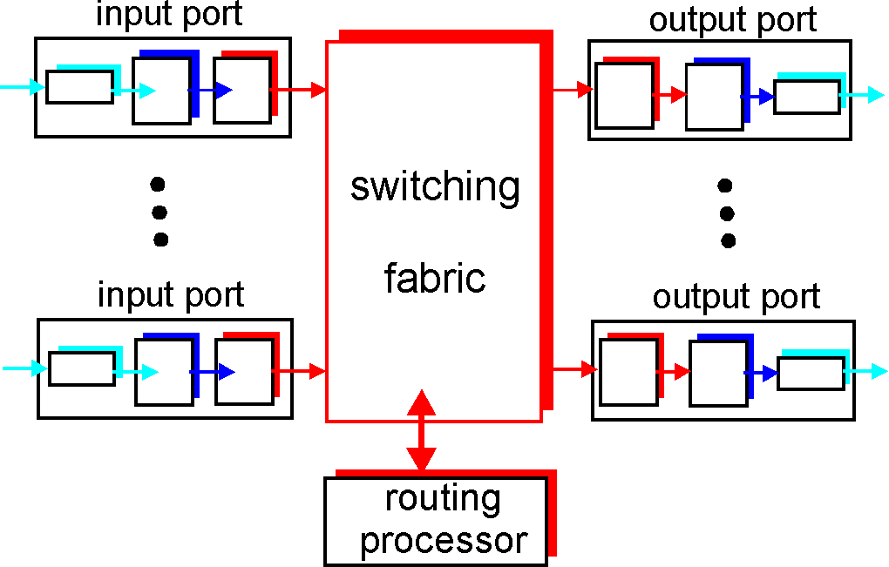
Router Architecture Overview
Four components :
Input Ports, Switching Fabric, Output Ports and Routing Processor

Slide 43
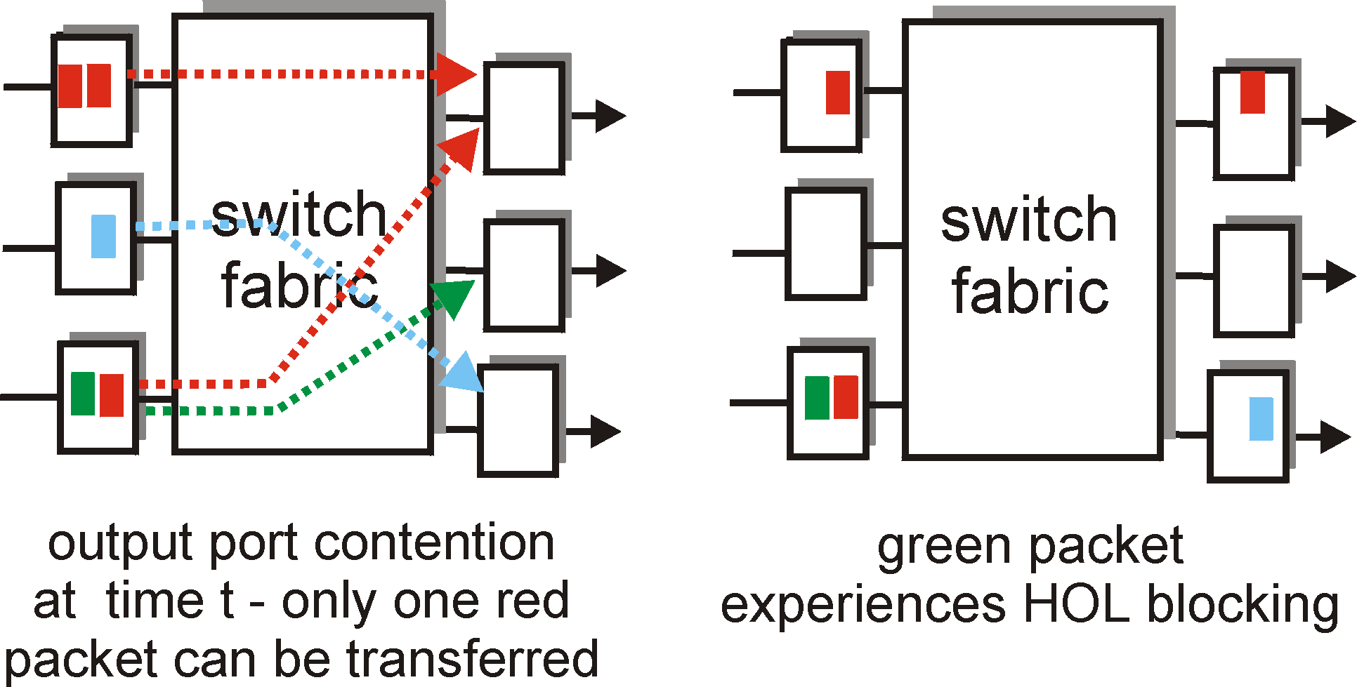
Where does Queuing Occur?
Input Port Queuing
Fabric slower than input ports combined -> queuing may occur at input queues
Queuing delay and loss due to input buffer overflow!

Slide 44
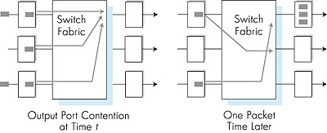
Where does Queuing Occur?
Output port queuing
buffering when arrival rate (via switch) exceeds output line speed
queuing can cause delay and loss due to output port buffer overflow!

Slide 45
Network Layer
Introduction
What’s inside a router
Routing algorithms
Link state routing algorithm
Distance-Vector algorithm

Slide 46
Graph Abstraction
5
v
3
w
2
5
u
2
1
z
3
1
2
x
y
1
Graph: G = (N,E)
N = set of routers = { u, v, w, x, y, z }
E = set of links ={ (u,v), (u,x), (u,w), (v,x), (v,w), (x,w), (x,y), (w,y), (w,z), (y,z) }
or edges, E.

Slide 47
Graph abstraction: costs
5
c(x,x’) = cost of link (x,x’)
- e.g., c(w,z) = 5
cost could always be 1, or
inversely related to bandwidth,
or inversely related to
congestion
v
3
w
2
5
u
2
1
z
3
1
2
x
y
1
Cost of path (x₁, x₂, x₃,…, x_{p}) = c(x₁,x₂) + c(x₂,x₃) + … + c(x_{p-1},x_{p})
Question: What’s the least-cost path between u and z ?
Routing algorithm: algorithm that finds least-cost path

Slide 48
Routing Algorithm classification
Global or decentralized information?
Global:
all routers have complete topology, link cost info
“link state” algorithms
Decentralized:
router knows physically-connected neighbours, link costs to neighbours
iterative process of computation, exchange of info with neighbours
“distance vector” algorithms
Static or dynamic?
Static:
routes change slowly over time
Dynamic:
routes change more quickly
periodic update
in response to link cost changes

Slide 49
Network Layer
Introduction
What’s inside a router
Routing algorithms
Link state
Distance-Vector

Slide 50
A Link-State Routing Algorithm
Dijkstra’s algorithm
net topology, link costs known to all nodes
accomplished via “link state broadcast”
all nodes have same info
computes least cost paths from one node (‘source’) to all other nodes
gives forwarding table for that node
iterative: after k iterations, know least cost path to k destinations
Notation:
c(x,y): link cost from node x to y; = ∞ if not direct neighbours
D(v): current value of cost of path from source to dest. v
p(v): predecessor node along path from source to v
N': set of nodes whose least cost path definitively known

Slide 51
Dijsktra’s Algorithm
1 Initialization:
2 N' = {u}
3 for all nodes v
4 if v adjacent to u
5 then D(v) = c(u,v)
6 else D(v) = ∞
7
8 Loop
9 find w not in N' such that D(w) is a minimum
10 add w to N'
11 update D(v) for all v adjacent to w and not in N' :
12 D(v) = min( D(v), D(w) + c(w,v) )
13 /* new cost to v is either old cost to v or known
14 shortest path cost to w plus cost from w to v */
15 until all nodes in N'

Slide 52
Dijkstra’s algorithm: example
Step
0
1
2
3
4
5
N'
u
ux
uxy
uxyv
uxyvw
uxyvwz
D(v),p(v)
2,u
2,u
2,u
D(w),p(w)
5,u
4,x
3,y
3,y
D(x),p(x)
1,u
D(y),p(y)
∞
2,x
D(z),p(z)
∞
∞
4,y
4,y
4,y
5
v
3
w
2
5
u
2
1
z
3
1
2
x
y
1

Slide 53
Dijkstra’s algorithm: example (2)
Resulting shortest-path tree from u:
v
w
5
u
v
3
w
z
5
2
x
u
2
1
z
y
3
1
2
x
y
Resulting forwarding table in u:
1
destination
link
v
(u,v)
x
(u,x)
y
(u,x)
w
(u,x)
z
(u,x)

Slide 54
Dijkstra’s algorithm, discussion
Algorithm complexity: n nodes
each iteration: need to check all nodes, w, not in N
n(n+1)/2 Complexity:O(n²)

Slide 55
Network Layer
Introduction
What’s inside a router
Routing algorithms
Link state
Distance-Vector

Slide 56
Distance Vector (DV) Algorithm
A decentralized routing algorithm
Compared with LS, DV algorithm is iterative, asynchronous and distributed
No global information, each node only receives some information from one or more of its directly attached neighbours

Slide 57
Distance Vector Algorithm
Bellman-Ford Equation (dynamic programming)
Define
d_{x}(y) := cost of least-cost path from x to y
Then
d_{x}(y) = min {c(x,v) + d_{v}(y) }
where min is taken over all neighbours v of x
v

Slide 58
Bellman-Ford example
5
Clearly, d_{v}(z) = 5, d_{x}(z) = 3, d_{w}(z) = 3
v
3
w
2
5
u
z
B-F equation says:
2
1
3
1
2
d_{u}(z) = min { c(u,v) + d_{v}(z),
c(u,x) + d_{x}(z),
c(u,w) + d_{w}(z) }
= min {2 + 5,
1 + 3,
5 + 3} = 4
x
y
1
Node that achieves minimum is next
hop in shortest path ➜ forwarding table

Slide 59
Distance Vector Algorithm
D_{x}(y) = estimate of least cost from x to y
Distance vector: D_{x} = [D_{x}(y): y є N ]
Node x knows cost to each neighbour v: c(x,v)
Node x maintains D_{x} = [D_{x}(y): y є N ]
Node x also maintains its neighbours’ distance vectors
For each neighbour v, x maintains D_{v} = [D_{v}(y): y є N ]

Slide 60
Distance vector algorithm (4)
Basic idea:
Each node periodically sends its own distance vector estimate to neighbours
When a node x receives new DV estimate from neighbor, it updates its own DV using B-F equation:
D_{x}(y) ← min_{v}{c(x,v) + D_{v}(y)} for each node y ∊ N
Under minor, natural conditions, the estimate D_{x}(y) converge to the actual least cost d_{x}(y)

Slide 61
Distance Vector Algorithm (5)
Iterative, asynchronous: each local iteration caused by:
local link cost change
DV update message from neighbour
Distributed:
each node notifies neighbours only when its DV changes
neighbours then notify their neighbours if necessary
Each node:
wait for (change in local link cost msg from neighbour)
recompute estimates
if DV to any dest has changed, notify neighbours

Slide 62
D_{x}(y) = min{c(x,y) + D_{y}(y), c(x,z) + D_{z}(y)} = min{2+0 , 7+1} = 2
D_{x}(z) = min{c(x,y) + D_{y}(z), c(x,z) + D_{z}(z)}
= min{2+1 , 7+0} = 3
node x table
cost to
cost to
cost to
x y z
x y z
x y z
x
0 2 7
x
0 2 3
x
0 2 3
y
y
from
∞
∞
∞
from
2 0 1
y
from
2 0 1
z
∞
∞
∞
z
7 1 0
z
3 1 0
node y table
cost to
cost to
cost to
x y z
x y z
x y z
y
2
1
x
∞
∞
x
0 2 7
z
∞
2 0 1
x
0 2 3
x
y
y
7
from
from
2 0 1
y
from
2 0 1
z
∞
∞
∞
z
7 1 0
z
3 1 0
node z table
cost to
cost to
cost to
x y z
x y z
x y z
x
∞ ∞ ∞
x
0 2 7
x
0 2 3
y
y
2 0 1
y
from
2 0 1
from
from
∞
∞
∞
z
z
3 1 0
z
3 1 0
7
1
0
time

Slide 63
Distance Vector: link cost changes
Link cost changes:
node detects local link cost change
updates routing info, recalculates distance vector
if DV changes, notify neighbours
1
y
4
1
x
z
50
At time t₀, y detects the link-cost change, updates its DV,
and informs its neighbours.
At time t₁, z receives the update from y and updates its table.
It computes a new least cost to x and sends its neighbours its DV.
At time t₂, y receives z’s update and updates its distance table.
y’s least costs do not change and hence y does not send any
message to z.

Slide 64
Distance Vector: link cost changes
Link cost changes:
good news travels fast
bad news travels slow - “count to infinity” problem!
44 iterations before algorithm stabilizes: see text
Please read section 4.5.2 of Kurose & Ross (Ed. 4)
60
y
4
1
x
z
50

Slide 65
Comparison of LS and DV algorithms
Message complexity
LS: with n nodes, E links, O(nE) msgs sent
DV: exchange between neighbours only
convergence time varies
Speed of Convergence
LS: O(n²) algorithm requires O(nE) msgs
DV: convergence time varies
may be routing loops
count-to-infinity problem
Robustness: what happens if router malfunctions?
LS:
node can advertise incorrect link cost
each node computes only its own table
DV:
DV node can advertise incorrect path cost
each node’s table used by others
error propagate thru network

Slide 66
Summary
How a router works
LS routing algorithm
DV routing algorithm

